Slide 1
Group
RAJESH KUMAR Deptt. Of Mathematics Govt. Degree College Bisauli Budaun

Slide 2
Binary Operation
Let 𝐺 be a set. A binary operation on 𝐺 is a function that assigns each order pair of elements of 𝐺 an element of 𝐺.
𝑓 ∶ 𝐺 × 𝐺 → 𝐺
Remark : o is a binary operation on 𝐺 iff aοb Є 𝐺.

Slide 3
Algebraic Structure
A non empty set together with one or more than one binary operation is called algebraic structure.
Examples :
1. (R,+, ∙) is an algebraic structure.
2. (N, +) , (Z, +), (Q, +) are algebraic structures.

Slide 4
Group
A non empty set 𝐺 together with an operation o is called a group if the following conditions are satisfied :
• Closure axiom,
∀ 𝑎,𝑏 ∈ 𝐺 ⇒ 𝑎𝑜𝑏 ∈ 𝐺.
• Associative axiom,
𝑎𝑜𝑏 𝑜𝑐 = 𝑎𝑜(𝑏𝑜𝑐) ∀ 𝑎,𝑏,𝑐 ∈ 𝐺
• Existence of identity,
∃ an element 𝑒 ∈ 𝐺, called identity 𝑎𝑜𝑒 = 𝑒𝑜𝑎 = 𝑎 ∀ 𝑎 ∈ 𝐺.
• Existence of inverse,
𝑎 ∈ 𝐺 , ∃ $a^{−1}$∈ 𝐺 𝑠.𝑡 $a^{−1}$𝑜𝑎 = 𝑎𝑜$a^{−1}$= 𝑒 This $a^{−1}$is called inverse of 𝑎.

Slide 5
Abelian Group
A group 𝐺,𝑜 is called abelian group or commutative group if 𝑎𝑜𝑏 = 𝑏𝑜𝑎 ∀ 𝑎,𝑏 ∈ 𝐺.
Examples :
1. (ℤ, +) ,( ℚ , +) ,(ℝ, +) all are commutative group.
($Q_{0}$, ∙) , ($ℝ_{0}$, ∙) are commutative group.
The set of all 𝑚 × 𝑛 matrics (real and complex) with matrix addition as a binary operation is commutative group. The zero matric is the identity element and the inverse of matric of A is –A.

Slide 6
Theorem :Uniqueness of identity
The identity 𝑒 in a group always unique. Proof If possible, suppose that 𝑒 and 𝑒′ are two identity elements in a group 𝐺.
𝑒 is an identity element
⇒ 𝑒𝑒′ = 𝑒′𝑒 = 𝑒′ 𝑎𝑒 = 𝑒𝑎 = 𝑎
𝑒′ is an identity element
⇒ 𝑒𝑒′ = 𝑒′𝑒 = 𝑒 [ 𝑎𝑒′ = 𝑒′𝑎 = 𝑎]
these statements prove that 𝑒 = 𝑒𝑒′ = 𝑒′𝑒 = 𝑒′
from which, we get 𝑒 = 𝑒′.

Slide 7
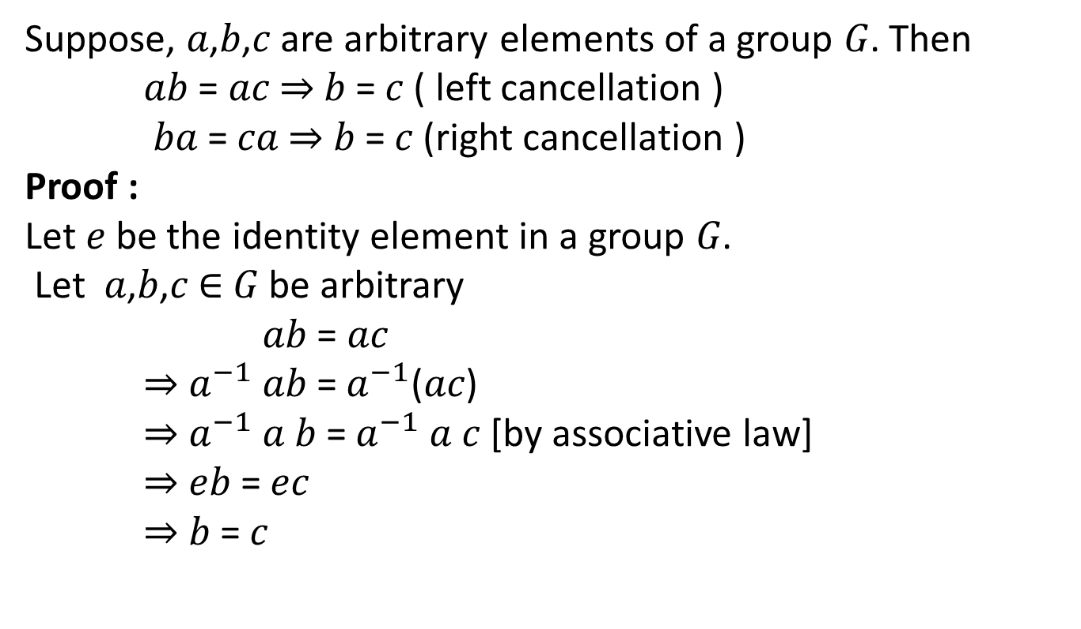
Theorem :The cancellation laws
Suppose, 𝑎,𝑏,𝑐 are arbitrary elements of a group 𝐺. Then
𝑎𝑏 = 𝑎𝑐 ⇒ 𝑏 = 𝑐 ( left cancellation )
𝑏𝑎 = 𝑐𝑎 ⇒ 𝑏 = 𝑐 (right cancellation )
Proof :
Let 𝑒 be the identity element in a group 𝐺.
Let 𝑎,𝑏,𝑐 ∈ 𝐺 be arbitrary
𝑎𝑏 = 𝑎𝑐
⇒ $a^{−1}$𝑎𝑏 = $a^{−1}$(𝑎𝑐)
⇒ $a^{−1}$𝑎 𝑏 = $a^{−1}$𝑎 𝑐 [by associative law]
⇒ 𝑒𝑏 = 𝑒𝑐
⇒ 𝑏 = 𝑐

Slide 8
Again 𝑏𝑎 = 𝑐𝑎
⇒ 𝑏𝑎 𝑎−1 = 𝑐𝑎 𝑎−1
⇒ 𝑏 𝑎𝑎−1 = 𝑐 𝑎𝑎−1
⇒ 𝑏𝑒 = 𝑐𝑒
⇒ 𝑏 = 𝑐
Example :
1. The positive integer form a cancellative semigroup under addition.
2. The non-negative integers form a cancellative monoid under addition.
3. The cross product of two vectors does not obey the cancellation law.
if 𝑎 × 𝑏 = 𝑎 × 𝑐,
then it does not follow that 𝑏 = 𝑐 even if 𝑎 ≠ 0.

Slide 9
4. Matrix multiplication also does not necessary obey the cancellation law.
AB = BC and A ≠ 0
Consider the set of all 2 × 2 matrices with integer coefficients. The matrix multiplication is defined by
$\left(\begin{matrix}a & b \\ c & d\end{matrix}\right)\left(\begin{matrix}a′ & b′ \\ c′ & d′\end{matrix}\right)$= $\left(\begin{matrix}\text{aa}\text{′ + }\text{bc}\text{′} & \text{ab}\text{′ + }\text{bd}\text{′} \\ \text{ca}\text{′ + }\text{dc}\text{′} & \text{cb}\text{′ + }\text{dd}\text{′ }\end{matrix}\right)$
It is associative, and $\left(\begin{matrix}1 & 0 \\ 0 & 1\end{matrix}\right)$is identity but the cancellation law does not follow
$\left(\begin{matrix}1 & 0 \\ 0 & 1\end{matrix}\right)\left(\begin{matrix}0 & 2 \\ 0 & 0\end{matrix}\right)$= $\left(\begin{matrix}0 & 0 \\ 0 & 0\end{matrix}\right)$and
$\left(\begin{matrix}1 & 0 \\ 0 & 1\end{matrix}\right)\left(\begin{matrix}0 & 3 \\ 0 & 0\end{matrix}\right)$= $\left(\begin{matrix}0 & 0 \\ 0 & 0\end{matrix}\right)$
This implies $\left(\begin{matrix}1 & 0 \\ 0 & 1\end{matrix}\right)\left(\begin{matrix}0 & 2 \\ 0 & 0\end{matrix}\right)$= $\left(\begin{matrix}1 & 0 \\ 0 & 1\end{matrix}\right)\left(\begin{matrix}0 & 3 \\ 0 & 0\end{matrix}\right)$
but$\left(\begin{matrix}0 & 2 \\ 0 & 0\end{matrix}\right)$≠ $\left(\begin{matrix}0 & 3 \\ 0 & 0\end{matrix}\right)$

Slide 10
Theorem :Uniqueness of inverse
The inverse of each element of a group is unique.
Proof :
If possible, let 𝑎 and 𝑏 be two elements of a group 𝐺,so that
𝑏𝑎 = 𝑎𝑏 = 𝑒 ...(1)
𝑐𝑎 = 𝑎𝑐 = 𝑒 ...(2)
𝑒 be an identity in 𝐺.
𝑏𝑎 = 𝑒 = 𝑐𝑎
or 𝑏𝑎 = 𝑐𝑎
𝑏 = 𝑐 [by right cancellation law.]

Slide 11
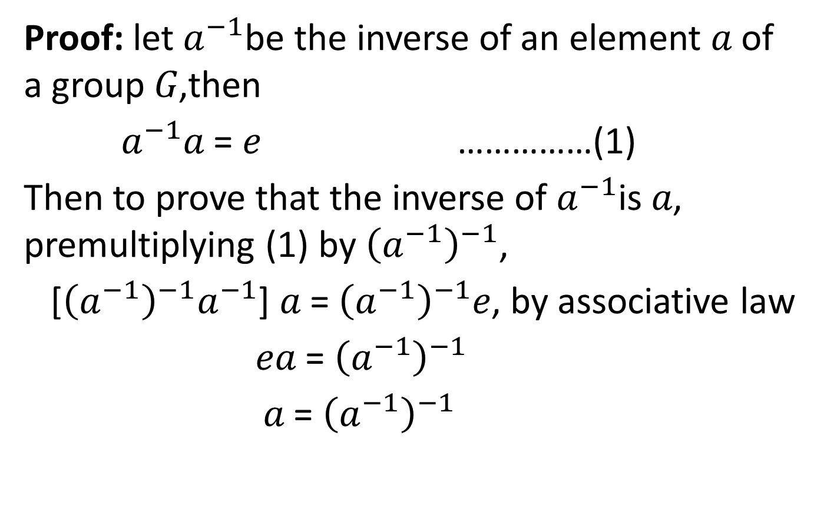
Theorem:If let 𝐺 be a group and 𝑎 ∈ 𝐺 then ${\left(a^{−1}\right)}^{−1}$= 𝑎.
Proof: let $a^{−1}$be the inverse of an element 𝑎 of a group 𝐺,then
$a^{−1}$𝑎 = 𝑒 ……………(1)
Then to prove that the inverse of $a^{−1}$is 𝑎, premultiplying (1) by ${\left(a^{−1}\right)}^{−1}$,
[${\left(a^{−1}\right)}^{−1}a^{−1}$] 𝑎 = ${\left(a^{−1}\right)}^{−1}$𝑒, by associative law
𝑒𝑎 = ${\left(a^{−1}\right)}^{−1}$
𝑎 = ${\left(a^{−1}\right)}^{−1}$

Slide 12
Thanks

